Slide 1
Explain the concept of Cloud Computing
Heteng zhang

Slide 2
cloud computing
Cloud computing is a technology that uses the internet for storing and managing data on remote servers and then access data via the internet.
reduces the need for physical data center and servers that people need to buy, own and maintain

Slide 3
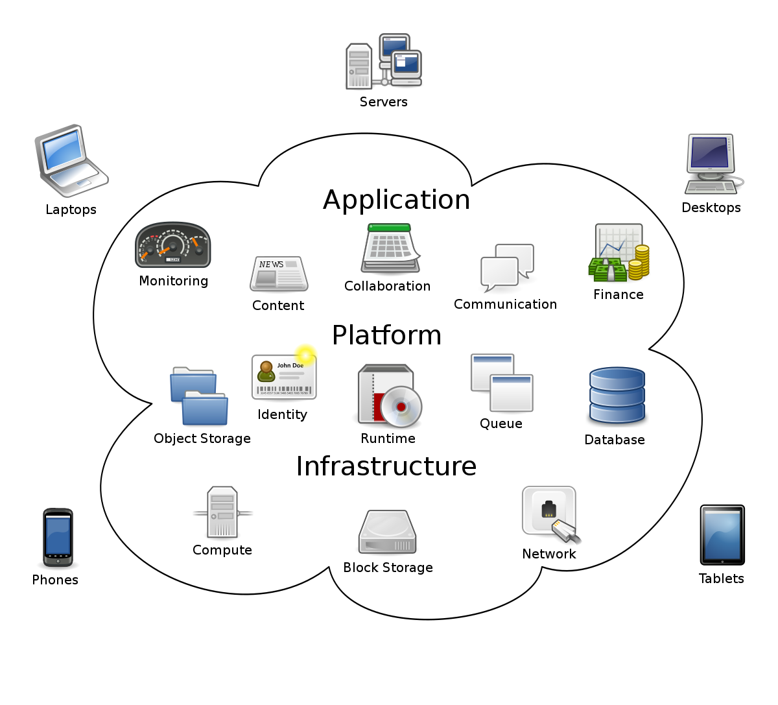
it can support different services through the Internet. These resources include tools and applications like data storage, servers, databases, networking, and software.
Cloud computing is a rapidly-growing industry which allows companies to move beyond on-premise IT infrastructure and, instead, rely on internet-based services

Slide 4
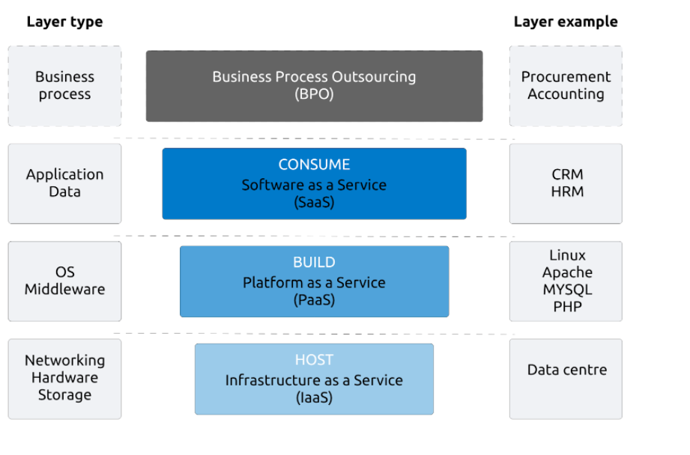
cloud computing model

Slide 5
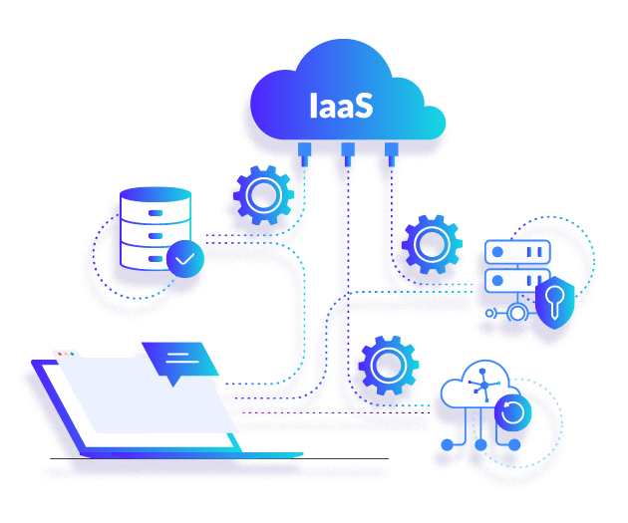
Infrastructure as a Service (IaaS)
People use IT infrastructure from a cloud provider.
it consist hardware and network, such as servers and storage, networking firewalls and security, and data centers.
businesses can use their own applications and platforms within the infrastructure that is delivered by a service provider.
Improved disaster recovery, Better security, stability, and reliability

Slide 6
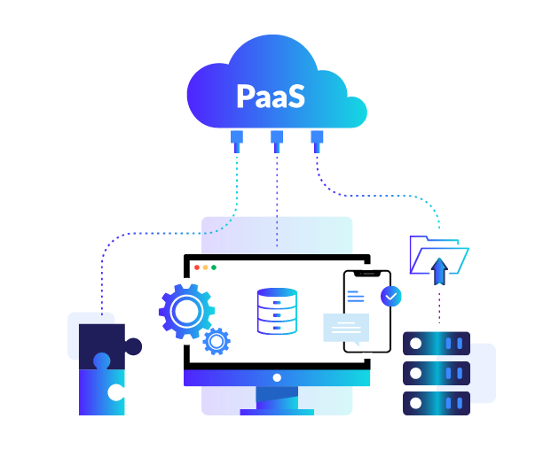
Platform as a Service (PaaS)
provides the resources to actually build applications.
Base infrastructure (IaaS), also provides the ability to develop, test, run, and host application

Slide 7
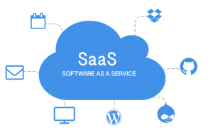
Software as a Service (SaaS)
provides a complete software solution
delivering applications over the Internet
simply access it via the Internet, freeing yourself from complex software and hardware management.
Example:
email software is located on the service provider’s network–together with your messages.

Slide 8
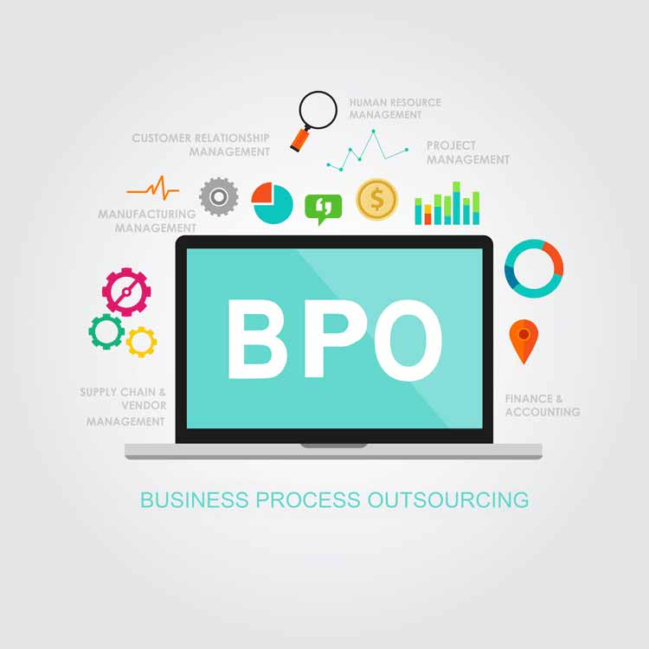
BPO (Business Process Outsourcing)
company outsources standard business functions to a third-party provider.
save time and money
not a technology

Slide 9
conclusion
Cloud computing has a great changing impact on the way businesses manage their information and data. It not only can access files on multiple devices
save storage space, lets users upgrade software more quickly.

